Slide 1
Unlearning the 5-paragraph Essay
Alternative Structures
&
Rhetorical Forms
Notes:
Before you move past this slide, ask students (in small groups, or as a class discussion) to identify major parts of the essay, and what they’ve been told NEEDS to be in an essay. What are the “rules?” How do they begin an introduction? How do they organize their ideas? Etc.. Let them get as much on the page/board as possible. Try out this activity: ask them what the new star wars trailer tells us about the plot. Then have them watch the honest trailer. What’s the difference? When they give the list of essay rules, ask them to be honest.

Slide 2
The format is familiar and easy
I. Introduction
Hook. Start with a quote?
Background
Thesis: argumentative statement with 3 points
II. Body Paragraphs
Topic sentence
Examples
Some kind of ending?
III. Conclusion
No one knows what goes here
Pretty sure we’re supposed to say everything we said again, except shorter
Notes:
Then reveal this slide of familiar formatting.

Slide 3
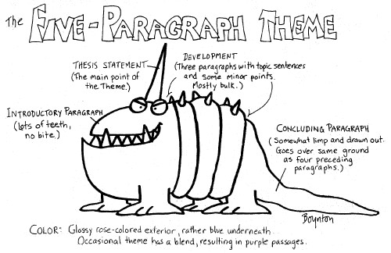

Slide 4
So why should we unlearn it?
3 points isn’t always enough
Filled with knowledge you already have
You write them last minute because you can
You don’t need to bother reading their research
It’s easy to learn, replicate, (and grade) without thought
usually not personalized (does the writer matter?)
not actually useful at persuasion
Fails to engage any critical thinking
Students write to satisfy the professor, not their own ideas
Ideas are only connected by the thesis, not context
Doesn’t allow for complex relationships between topics
They’re literally only used in English classrooms

Slide 5
Well, what are we supposed to do instead?
Benefits of rethinking these approaches:
Versatility
If you start with the rhetorical* needs of the writing
Allows for overlapping structures
Allows for discussion of complex or abstract ideas and for discussing varied relationships
*the tools we use to communicate effectively

Slide 6
What are some natural thinking patterns we can use in essays?
Notes:
Now is a good time to pause and see if the students can provide any ideas here. It’s a good idea to push them y asking them to look at their phone’s search history and see what information they *needed* and how they would go about organizing it if they had to. It’s okay if they can’t put these ideas into words yet, but it’s important that they try.

Slide 7
PARTIONING: sorting material into thematic or logical categories
Enumeration is used for other logical categories
Classification: the process of sorting many small ideas into larger themes
Division: the process of breaking one topic down into smaller components

Slide 8
SERIATION: ordering ideas according to a logical plan
Degree / Rank:
sorting by importance, need, or merit
Development:
sorting by evolving stages (often chronological stages)
Spatial Ordering:
sorting information based on its physical location/relationship to other information.
Comparison / Contrast:
the process of sorting similarities or differences according to a mutual factor

Slide 9
CONSEQUENCE: dividing an idea into the eventual ends and the means to them
Causation / Effect:
division into causes and effects
Process:
division into procedures and goals

Slide 10
Clarifying: ordering information based on the needs of the reader and the logic
Definition:
explaining the meaning of words or concepts based on etymology, denotation, connotation, and perspectives over time
Exemplification:
the process of taking a concept and providing several like or unalike examples in support of a goal
(INTERNAL PATTERN) Summary:
indicates a condensed review of an idea or a piece of writing to confirm understanding
(INTERNAL PATTERN) Analogy:
creating a comparison between concepts, using an easy to understand concept to explain a more difficult concept

Slide 11
ARGUMENT: dividing ideas into claims and proofs
Inference:
(deductive reasoning)division into premises and conclusions (used in formal logic)
Hypothesis:
(inductive reasoning) the division of ideas into specific observations about the world and the logical, general conclusions we can make based on rational thinking.
Choice:
division into options and final selection
Problem / Solution:
division into problem, causes, and resolutions
Dialectic:
division into antithesis and synthesis (essentially, the compromise: a dilemma is resolved, not by choosing a side, but by merging two options to form a new position)
Aristotelean:
a five part structure of arguments– Introduction, Narration, Confirmation, Refutation, and Epilogue
Rogerian:
an argument that, instead of choosing a side, compares the audience’s and author’s perspectives to find common ground
Notes:
No need to go over each of these. It’s enough to show them the difference between two of them, for instance Aristotelean and something like Rogerian.

Slide 12
CREATIVE: approach to an idea via figurative language or lifestyle
Narration:
discussion of personal beliefs and why they’re held
Description:
presentation of an idea as a whole image, not up for argument
(INTERNAL PATTERN) Exposition:
a comprehensive description of an explanation or idea, usually intended to profile the concept
(INTERNAL PATTERN) Illustration:
creates a picture of a specific instance of an event or concept, especially in order to make abstract ideas more concrete

Slide 13
OVERLAPPING AND COMBINING PATTERNS:
Causal chain:
one effect becomes the cause of a second causation
Sorities:
the conclusion of one inference becomes the premise to a second inference (uses formal logic)
Sequence:
division into order of operations when multiple rhetorical choices must be used in order

Slide 14
These work because they mimic natural ways of thinking about the world

Slide 15
KEYWORDS FOR WRITING PATTERNS
Also called signal words
When in doubt, look it up!
Here
Are
Some
Examples

Slide 16
Let’s try out one style
Think for a moment about a few topics you care about
List at least 5 topics
Select one of those topics and fill in the following sentences:
What most people believe about [topic] is …..
Which makes sense, because at first glance….
However, with a closer look at [topic]….
You could use this structure to develop your essay into three majors parts
However, using the previous list, identify a few other rhetorical strategies that might help you prove your specific point about your topic.
Notes:
Have the students work on this slide first by themselves. Ask at least 3 students to share their ideas. As a class, work with the students to identify a rhetorical thinking pattern from the previous slides that we might also use with the 3 shared topics, to reveal something else. The goal is to help them see how the patterns of writing change the goal of the questions.

Slide 17
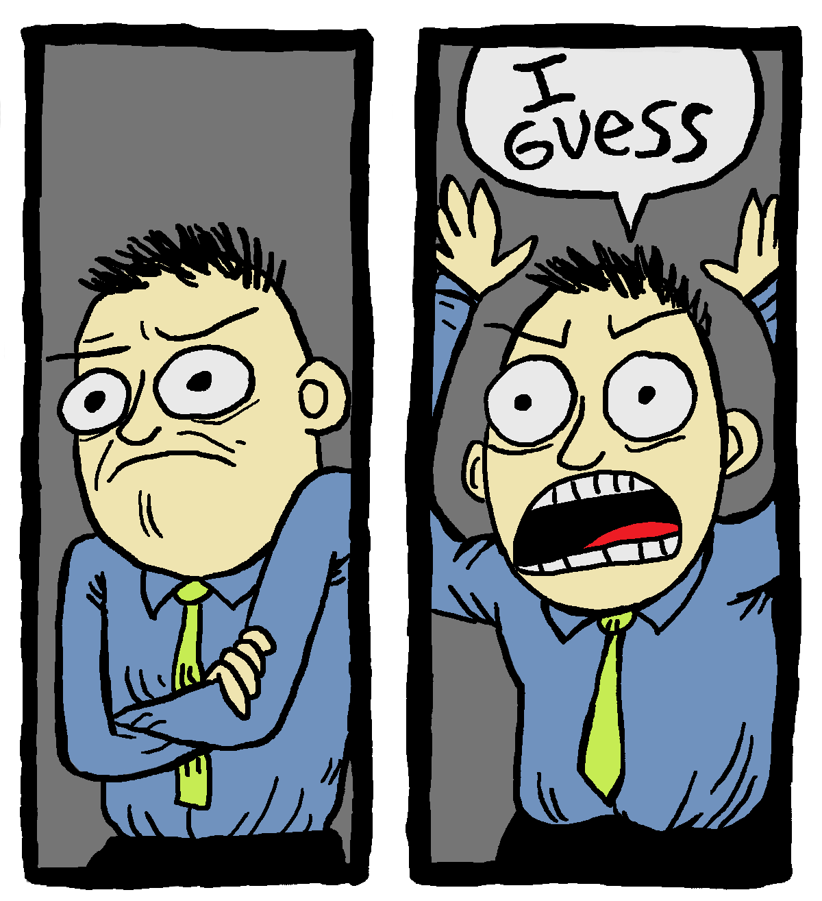
Ultimately, no writing style is satisfied by the 5-paragraph essay form
Except essays which require five paragraph structure

Slide 18
Using the Patterns
GENRES
Purpose / Goals
General structure
Audience expectations
FORMULAS
Step-by-step
Necessary parts
Exceptions

Slide 19
Genres and Structures
Narrative Genre = Major Goals and Situations
Screenplay Format = Structural formula, parts, how-to

Slide 20
Narrative Pattern
Objectives: To tell a first-person story involving real or imagined events, characters, and settings. The narrative usually carries some sort of message for the audience, usually sparking understanding, empathy, or including a moral lesson.
Rhetorical Considerations: Take your audience into consideration, and make sure you have a complete story to tell: a clear beginning and ending that make sense and wrap up loose ends. The audience should be able to read your narrative without knowing you or needing to ask questions to understand the story. You can avoid this by focusing on two story elements: the characters, and the conflicts they encounter. Setting and Dialogue should also be included in narratives. Usually, writers also call upon the Descriptive pattern to enhance the narrative.
Organization: The introduction should contain relevant information about the characters, setting, and conflict. A narrative thesis should help clarify the larger life topic you're addressing, and what can be learned from the narrative about similar people or experiences. Each event or "scene" in the narrative is usually given its own paragraph, or you can choose to use body paragraphs to show transitions in place or time. Use transitions to clarify the chronological order of events. It's important, in the conclusion, to make sure it's obvious how and why your character(s) changed, as well as helping your readers understand the importance of your story to their own lives.

Slide 21
Analyzing Structures Homework:
Read
Read one of the five essays provided on canvas
Outline
Outline its structure.
Write
Write a conclusion about the structure you believe the author is using. [“Analyzing Structures” assignment]

Slide 22
Thesis Statements, Transitions, & Topic Sentences

Slide 23
Thesis Statements
The heart of the essay

Slide 24
Thesis Statements
Structure:
Subject + position + three points
EXAMPLE:
“High School education has several problems which must be solved in order to prepare America’s youth for the challenges of the 21st-century, namely overcrowding, increasing crime, and lack of tech.”
Issues:
vague wording
lack of cohesion or relationship between topics
States the obvious
Leaves no room for disagreement?
Topic is too general
Notes:
What’s wrong with that?
Often leads to

Slide 25
Instead, Try This
Structure:
Specific topic + debatable view + significance to audience
EXAMPLE:
“Solving the problem of overcrowding would allow more students to get the instruction they need to become productive members of society, which is the most important goal in education in America today.”
FIXES:
Develops a single idea in depth
A rational disagreement would be about the goal of education in America, or about which problem needs to be solved first.
Direct cohesion between the problem and the solution
Notes:
What’s wrong with that?
Often leads to

Slide 26
Structure & Thesis
As a student, you’ll practice during college creating thesis statements that guide your essays’ structures
But in order for that to happen, we need to know what kind of thinking is expected of us
Sometimes you’ll get this information from a prompt, telling you to write a comparison/causal analysis/etc essay
Other times, you’ll only get key words: discuss the effects of… talk about the benefits of… Why does….
Notes:
Let’s revisit this thesis:
“Solving the problem of overcrowding would allow more students to get the instruction they need to become productive members of society, which is the most important goal in education in America today.”
What kind of thinking does this thesis suggest we need to focus on?

Slide 27
How the thesis affects organization
5 paragraph essay:
Education in America is facing a lot of issues
Overcrowding interferes with instruction
Increasing crime makes students unable to work
Lack of tech resources means students are not prepared for the work force
Conclusion stating that all these points, shockingly, still matter and are, like, totally connected

Slide 28
How the thesis affects organization
The better essay, focused on causes, effects, process, and on argument:
The primary goal of a high school education is to make all students productive members of society [argument]
As jobs become more competitive, more people need and seek higher education [premise]
Budget cuts mean fewer teachers in schools, which reduces the quality of the classroom and instruction [effect]
Teachers get burned out when classes are overcrowded [effect]
In overcrowded classrooms, too many students slip through the cracks [causal chain]
Conclusion suggesting what the result of solving the problems might mean for society
http://web.csulb.edu/~eguzik/fivepara.html

Slide 29
Genres and Structures
Narrative Genre = Major Goals and Situations
Screenplay Format = Structural formula, parts, how-to

Slide 30
Narrative Pattern
Objectives: To tell a first-person story involving real or imagined events, characters, and settings. The narrative usually carries some sort of message for the audience, usually sparking understanding, empathy, or including a moral lesson.
Rhetorical Considerations: Take your audience into consideration, and make sure you have a complete story to tell: a clear beginning and ending that make sense and wrap up loose ends. The audience should be able to read your narrative without knowing you or needing to ask questions to understand the story. You can avoid this by focusing on two story elements: the characters, and the conflicts they encounter. Setting and Dialogue should also be included in narratives. Usually, writers also call upon the Descriptive pattern to enhance the narrative.
Organization: The introduction should contain relevant information about the characters, setting, and conflict. A narrative thesis should help clarify the larger life topic you're addressing, and what can be learned from the narrative about similar people or experiences. Each event or "scene" in the narrative is usually given its own paragraph, or you can choose to use body paragraphs to show transitions in place or time. Use transitions to clarify the chronological order of events. It's important, in the conclusion, to make sure it's obvious how and why your character(s) changed, as well as helping your readers understand the importance of your story to their own lives.

Slide 31
Try on your own:
(Using the narrative experience you’ve chosen this week) identify one or a few ways you think sharing this experience has value for the reader.
Phrase that statement in a single, declarative sentence.

Slide 32
MINUTE THESIS ACTIVITY!!!

Slide 33
Topic Sentences

Slide 34
Topic Sentences
Usually the first sentence of a paragraph
Each paragraph should cover a single idea
Large ideas should be broken down into separate paragraphs
body “sections” are more appropriate than body “paragraphs”
And that’s why topic and linking sentences are so important
The reader unconsciously uses keywords in your topic sentences to decide where they are in the pattern

Slide 35
Topic Sentences
Are always a statement of the writer’s belief
Never a fact
Never a quote
Never a question
Usually provides a transition from the previous ideas to the new ideas.
They should avoid stating the obvious, so as not to bore the reader.

Slide 36
Which of the following would NOT be an appropriate topic sentence?
I am going to explain how self-driving cars are better for the environment.
There are many possible contributing factors to global warming.
Teen pregnancy rates may be prevented by improved sex education.
The first true fax machines appeared in the 1840s.
Remodeling a kitchen successfully requires research and a good eye.
Researchers suggest that bees seek out honey in four different ways.

Slide 37
How to Fix the Issues
Make it Thorough (But brief)
The first true fax machine appeared in the 1840s.
Technological advancements in the 1840s created a need for faster communication and ushered in the first true fax machines.
Make it precise
I am going to explain how self-driving cars are better for the environment.
While self-driving cars do not eliminate pollutants, their improved efficiency is a huge step toward a cleaner future.

Slide 38
How to Fix the Issues
Make it your own
Researchers suggest that bees seek out honey in four different ways.
It’s important to understand the various systems bees use to locate honey before we try to replicate them.
Make it new
There are many possible contributing factors to global warming.
The dizzying array of possible contributing factors to global warming are part of the reason that most people don’t study the science in their spare time.

Slide 39
Topic Sentence Practice!
Highlight your thesis statement
Highlight the first sentence of every body paragraph
Read ONLY those sentences

Slide 40
Topic Sentence Practice
Travel to each of the stations around the room
write a topic sentence you believe would tie the paragraph together
include a specific subject, a debatable viewpoint, and the significance of the claim to the audience.

Slide 41
Linking Sentences Regardless of how good your defense is, readers will lose interest if you don’t address why your argument matters
Who Cares? (identify a person or group of readers)
Can help create dramatic tension between views that readers will want to see resolved in your writing
So What? (real-world applications and consequences)
Helps when readers may not feel invested in a clashing of views.
Appeal to something that your actual audience already cares about, or some larger matter that readers deem important

Slide 42
Example
Scientists used to think body fat and the cells it was made of were pretty much inert, just an oily storage compartment. But within the past decade research has shown that fat cells act like chemical factories and that body fat is potent stuff: a highly active tissue that secretes hormones and other substances with profound and sometimes harmful effects…In recent years, biologists have begun calling fat an “endocrine organ,” comparing it to glands like the thyroid and pituitary, which also release hormones straight into the bloodstream. Researchers trying to decipher the biology of fat cells hope to find new ways to help people get rid of excess fat or, at least, prevent obesity from destroying their health. In an increasingly obese world, their efforts have taken on added importance.

Slide 43
Using your thesis statement
See if you can give yourself a rough outline of topic sentences.
You can have as many sentences as you think you need to explain a pattern or make your point clearly.
Consider what ideas will link and transition between your points.

Slide 44
Transitions

Slide 45
Transitions
…establish logical connections between sentences, paragraphs, and sections of your papers.
…tell readers what to do with the information you present to them.
https://writingcenter.unc.edu/tips-and-tools/transitions/

Slide 46
Transitions are found…
Between large sections of content
To summarize and/or preview
Between paragraphs
Highlight relationships that exist between content
Within paragraphs
Cues to help readers understand information

Slide 47
Organization of Ideas
the order in which you have chosen to present the different parts of your discussion or argument
the relationships you construct between these parts.
Transitions cannot substitute for good organization, but they can make your organization clearer and easier to follow.

Slide 48
Example
Scientists used to think body fat and the cells it was made of were pretty much inert, just an oily storage compartment. But within the past decade research has shown that fat cells act like chemical factories and that body fat is potent stuff: a highly active tissue that secretes hormones and other substances with profound and sometimes harmful effects…In recent years, biologists have begun calling fat an “endocrine organ,” comparing it to glands like the thyroid and pituitary, which also release hormones straight into the bloodstream. Researchers trying to decipher the biology of fat cells hope to find new ways to help people get rid of excess fat or, at least, prevent obesity from destroying their health. In an increasingly obese world, their efforts have taken on added importance.

Slide 49
Transition Practice
El Pais, a Latin American country, has a new democratic government after having been a dictatorship for many years. Assume that you want to argue that El Pais is not as democratic as the conventional view would have us believe.
Par. 1: reasons one might consider El Pais democratic
Par. 2: refute the above with reasons it’s not democratic
The transition will need to indicate to readers that the second paragraph is a contradiction of the first.

Slide 50
Which of the following categories would be appropriate for the transition?
Change in time
Additional Information
Contrast
Comparison
Illustration
Location
Causation
Effects
Summary
Clarification

Slide 51
Examples of Transitions that Signal Contrast
Despite the previous arguments…
However, we should also consider…
In spite of the above examples..
On the other hand…

Slide 52
A Note about Intros and Conclusions

Slide 53
Students will be able to…
analyze the comparisons between google maps and introductions / conclusions
01
identify the techniques used in an introduction or a conclusion
02
analyze introductions and conclusions for their value
03
write successful introductions and conclusions
04

Slide 54
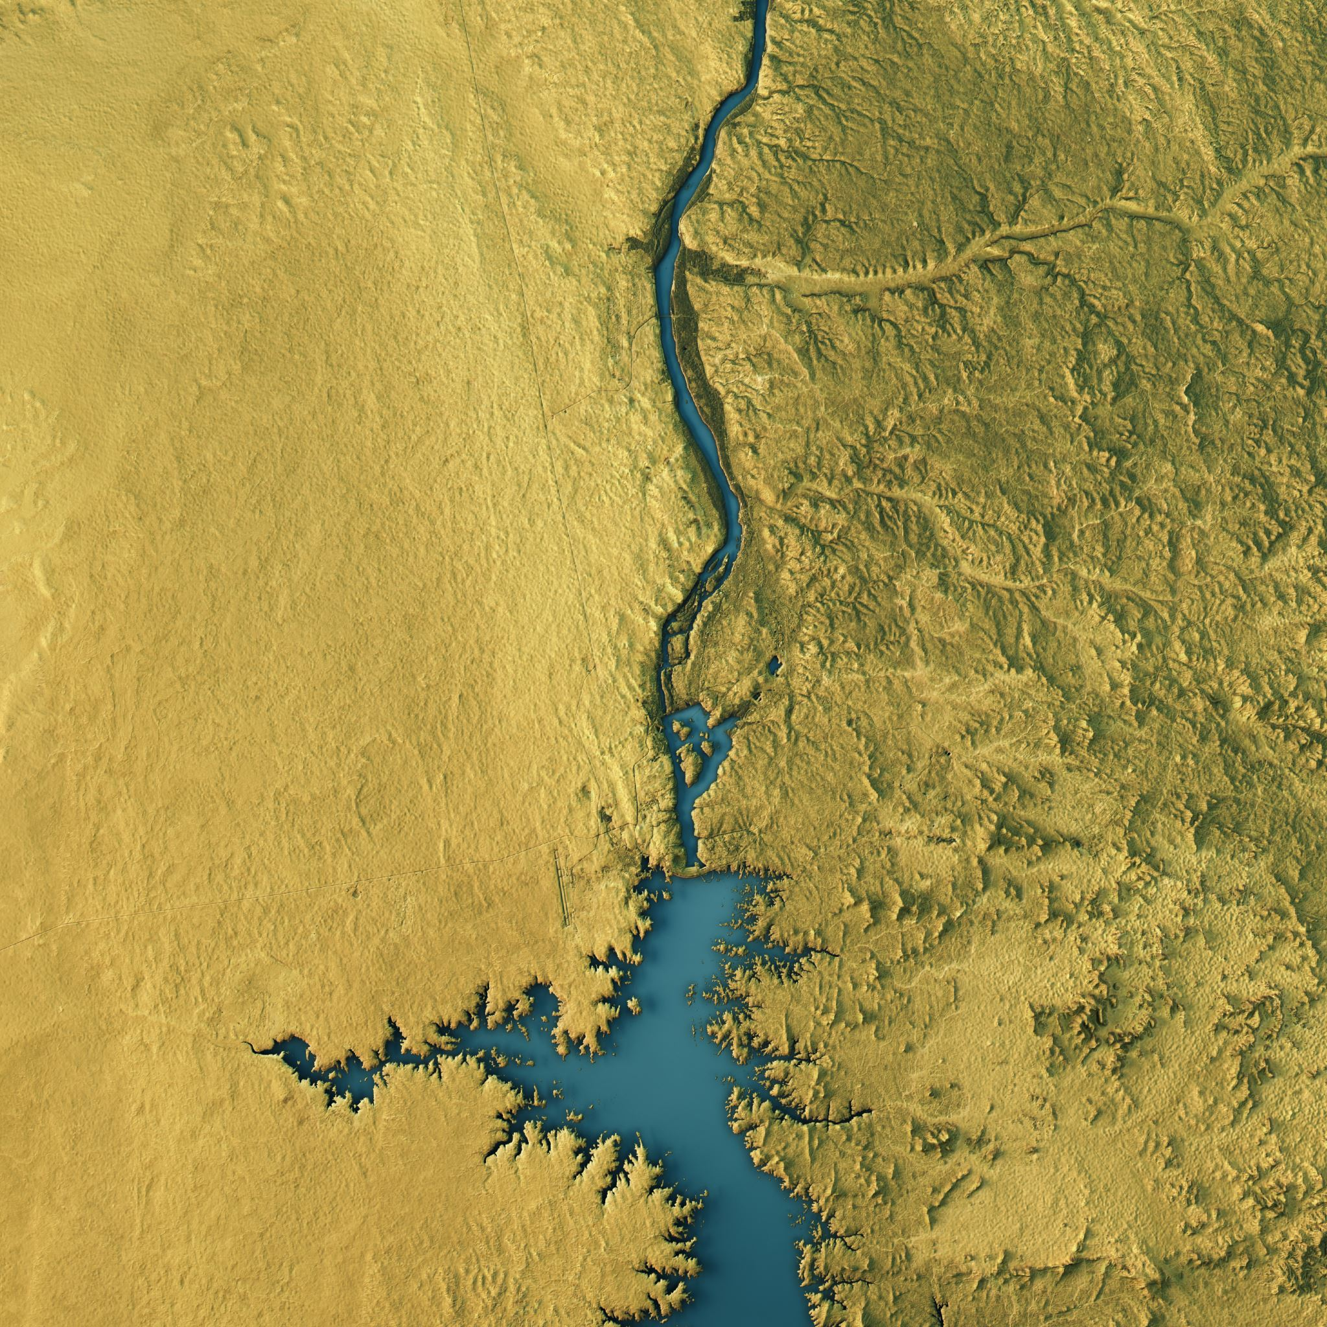
On the next slide, you’re going to see the Google Maps landing screen. Point out as many features of the map as you can…

Slide 55
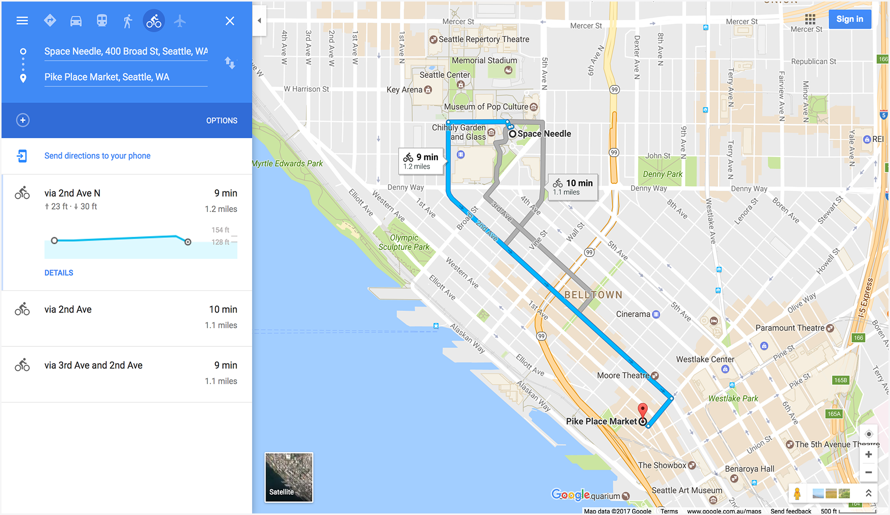

Slide 57
What’s on your list?
Starting point
Destination
Different routes available
Types of transportation
The surrounding area on the map
Major landmarks
Distance and time to travel
Turn by turn instructions

Slide 58
What our directions provide
Only enough context to understand our place in the world
The specific starting knowledge
Orientation
Mode of transportation
Time to destination and mileage
The specific location of the end
With a report of the actual distance and time (comparative to the starting assumptions)
Only the directions necessary to approach this topic
But relevant contextual information along the way
Traffic, tolls, detours, alternate routes, locations along the way

Slide 59
Each of these are map parts are similar to components of the introduction of an essay

Slide 60
What’s on your list?
(Starting Point) Reader’s current knowledge of the topic
(Destination) What you want to prove
(Different Routes) Different ways to reach an audience
(Transportation) Different modes of essays / genres
(Surrounding Area) Context for the argument in our world
(Landmarks) Major ideas and themes
(Distance/Time) How in depth or long your essay will be
(Turn directions) A step by step guide of the points you’ll cover

Slide 61
Your essay is a journey across a map
INTRODUCTIONS
These are invitations from the speaker, to the reader, to join you in discovery
They should appeal to the reader’s needs for tone, background, and knowledge
They should place the problem in context and suggest something about organization
Doesn’t need to be one paragraph; thesis doesn’t need to be the last sentence, OR have three parts.

Slide 62
Conclusions are similar to Introductions
CONCLUSIONS
This DOES NOT, EVER, NEVER, summarize the paper
We just read it
Like… why would we need that
Instead, develop your final, most significant point
Explain your understandings or findings with the context that the body provides to this explanation
Assume we have needed the information and are now ready to approach this last point

Slide 63
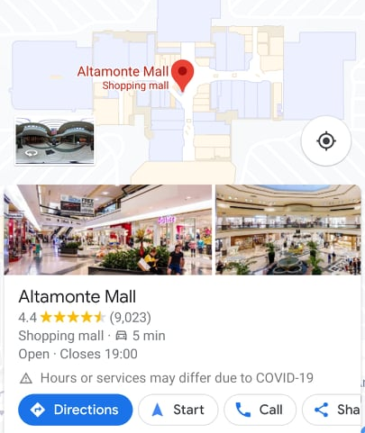
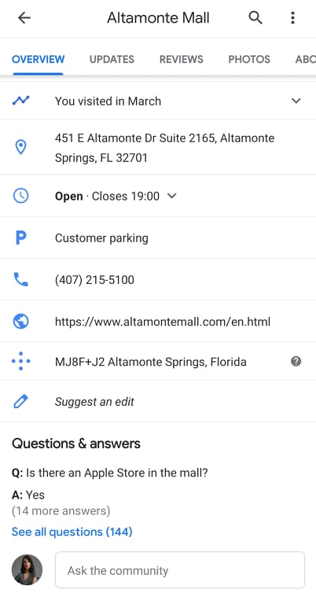
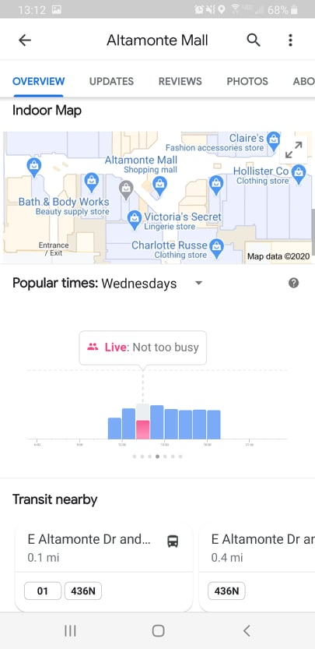

Slide 64
We can learn conclusions from maps as well
Information pertinent to the reader’s interests and values
Answering outstanding questions
A closer look at the place we’ve arrived
Popularity or social reception of the proven claim
When this information matters
How to use the information moving forward
Related topics and themes to the proven claim
What to do next, a call to action

Slide 65
Let’s start with big helpful approaches to developing topics

Slide 66
The Vowel Approach
ASSERTION: what are you claiming is true about the topic?
EVIDENCE: what evidence is there for your claim?
IMPORTANCE: why is your claim important? Who or what does it affect?
OBJECTIONS: Why might someone disagree with your claim?
UNDERSTANDING: What do we gain from supporting your claim? Or what might this help us understand beyond your assertion?

Slide 67
The SOAPSTone Approach
This acronym helps us understand the outside forces that control the content, structure, and style of our message.
This is also referred to as the rhetorical context which we’ll cover in Unit III
SUBJECT: What the text will be about
OCCASION: [time and place, context] what is compelling your writing? Is it contemporary? Relevant to your life?
AUDIENCE: the group of readers to whom the text is directed
PURPOSE: the goals of the text
SPEAKER: The person providing the text
TONE: the attitude of the speaker about the subject that will influence the diction and language
You can thank the AP Language Association for this one

Slide 68
Just Remember
There is no one “right” way to develop and organize an essay, only methods that are appropriate (or inappropriate) for the rhetorical situation

